Slide 1
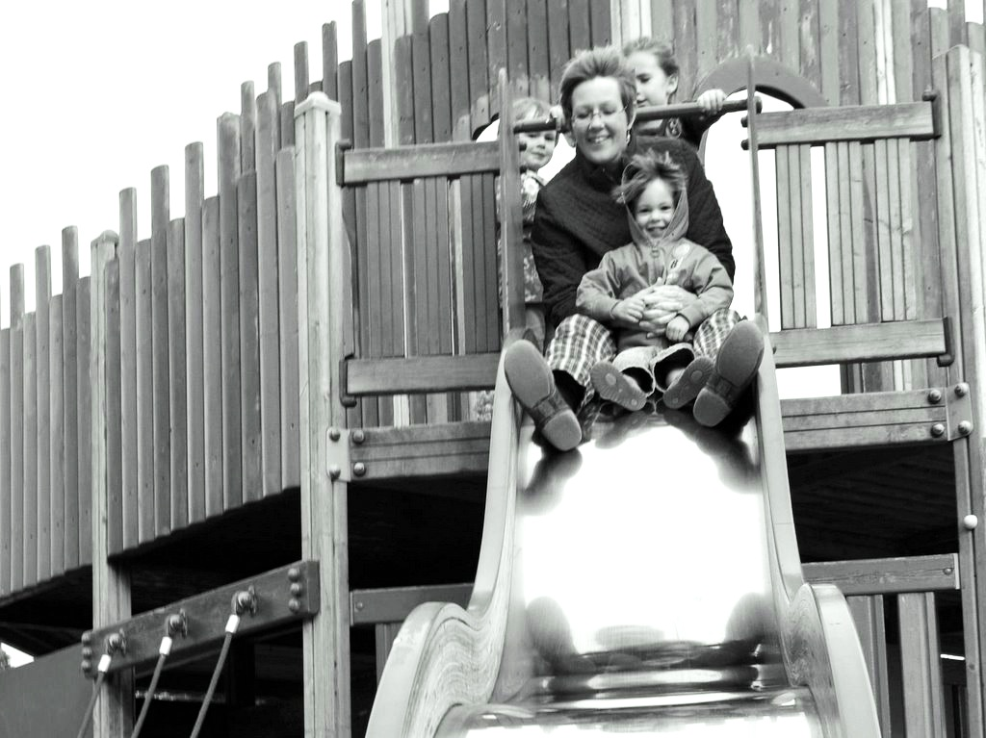
Minimal
Theory of Mind
and
Joint Action
s.butterfill@warwick.ac.uk

Slide 2
